Slide 1
VALUE
Dictionary meaning of value:
the regard that something is held to deserve; the importance, worth, or usefulness of something
Definition of value:
Basic conviction that a specific mode of conduct or end- state of existence is personally or socially preferable to an opposite or converse mode of conduct or end-state of existence.

Slide 2
Value attribute
Content attribute:
Mode of content or end state is important.
Intensity attribute:
Specifies how important it is
Value system:
Rank value in terms of intensity
Hierarchy of values

Slide 3
Values fluid and flexible
Established in early years
Certain behavior or outcomes always desirable
Black white

Slide 4
Importance of values
Foundation of understanding in individual
Ought or not
Interpretation of wrong and right
Cloud of objectivity n rationality
Influence attitude n behavior
example pay

Slide 5
Terminal v.s instrumental value
Rokeach value survey
Terminal value: desirable end-state, goal to be achieved
Instrumental value: preferable mode of behavior, means to achieve terminal value
Several survey confirm that value vary among groups

Slide 6
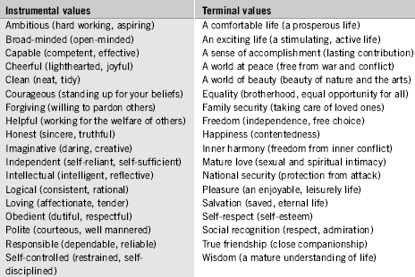
Rokeach value survey

Slide 7
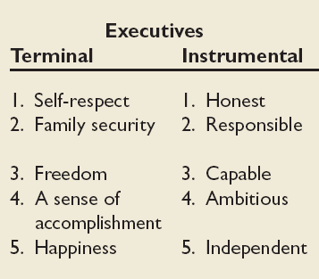
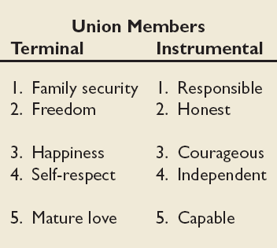
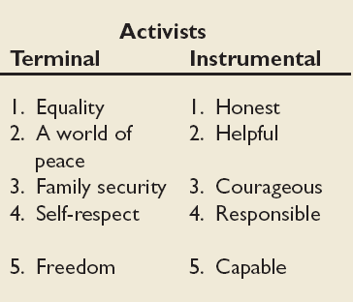
mean value rankings of executives union members and activists

Slide 8
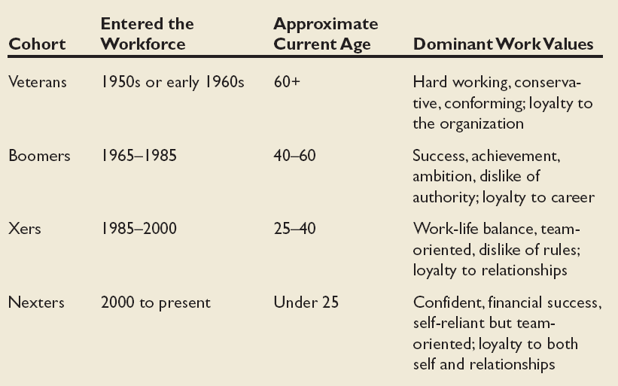
Contemporary Work Cohorts

Slide 9
. Veterans
Workers who entered the workforce from the early 1940s through the early 1960s and exhibited the following value orientations:

Slide 10
a) Influenced by the Great Depression and World War II.
b) Believed in hard work.
c) Be loyal to their employer.
d) Terminal values: Comfortable life and family security

Slide 11
Boomers
Employees who entered the workforce during the 1960s through the mid 1980s belonged to this category and their value orientations were:

Slide 12
a) Influenced heavily by John F. Kennedy, the civil rights and feminist movements, the Beatles, the Vietnam War, and baby boom competition. b) Distrusted authority, but gave a high emphasis on achievement and material success.

Slide 13
c) Organizations who employed them were vehicles for their careers. d) Terminal values: sense of accomplishment and social recognition.

Slide 14
Xers
Began to enter the workforce from the mid1980s. They cherished the following values:

Slide 15
a) Shaped by globalization, two career parents, MTV, AIDS, and computers. b) Value flexibility, life options, and achievement of job satisfaction. c) Family and relationships were important and enjoyed team oriented work.

Slide 16
d) Less willing to make personal sacrifices for employers than previous generations. e) Terminal values: true friendship, happiness, and pleasure.

Slide 17
Nexters
Most recent entrants into the workforce.

Slide 18
a)Grew up in prosperous times, have high expectation, believe in themselves, and confident in their ability to succeed. b) Never ending search for ideal job; see nothing wrong with job hopping.

Slide 19
c) Seek financial success. d) Enjoy team work, but are highly self reliant. e) Terminal values: freedom and comfortable life.

Slide 20
Values, Loyalty, and Ethical Behavior

Slide 21
Ethical Values and Behaviors of Leaders
Ethical Climate in the Organization

Slide 22
Define hofstede’s culture theory
Geert Hofstede's theory of cultural dimensions describes the effects of a society's culture on the values of its members, and how these values relate to behavior, using a structure derived from factor analysis.

Slide 23
Example:-
He surveyed more than 116000 1BM employees in 40 countries about work related values.
He found that managers and employees vary on work -related values
They are listed and defined as follows:-

Slide 24
Power distance:-
A national culture attribute describing the extent to which a society accepts that power in institutions and organizations is distributed unequally.
Individualism versus collectivism:-
Individualism:-
A national culture attribute describing the degree to which people prefer to act as individuals rather than as member of groups

Slide 25
Collectivism:-
A national culture attribute that describes a tight social framework in which people expect others in groups of which they are a parts to look after them and protect them.
Quantity versus Quality of life:-
Quantity of life:-
A national culture attributes describing the extent to which societal values are characterized by assertiveness and materialism

Slide 26
Quality of life:-
A national culture attribute that emphasizes relationships and concern for others
Uncertainty avoidance:-
A national culture attribute describing the extent to which a society feels threatened by uncertain and ambiguous situations and tries to avoid them.

Slide 27
LONG AND SHORT TERM ORIENTATION:-
Long –term orientation:-
A national culture attribute that emphasizes the future thrift and persistence.
Short –term orientation:-
A national culture attributes that emphasizes the past and present respect for tradition and fulfilling social obligations.

Slide 28
Here are a few highlight:-
China and west Africa scored high on power distance.
United states ranked highest among all countries on individualism.
And many others like this

